Slide 1
CSIT6910D
Independent Project
3rd Meeting
ZHANG Zhengyao

Slide 2
Agenda
Project Background
Recap from 2nd meeting
Methodologies / Implmenetations
Logic Routing
Agent & Tools
RAG - SQL/Vector DB
Future Direction
Functionality Optimization
Performance Evaluation

Slide 3
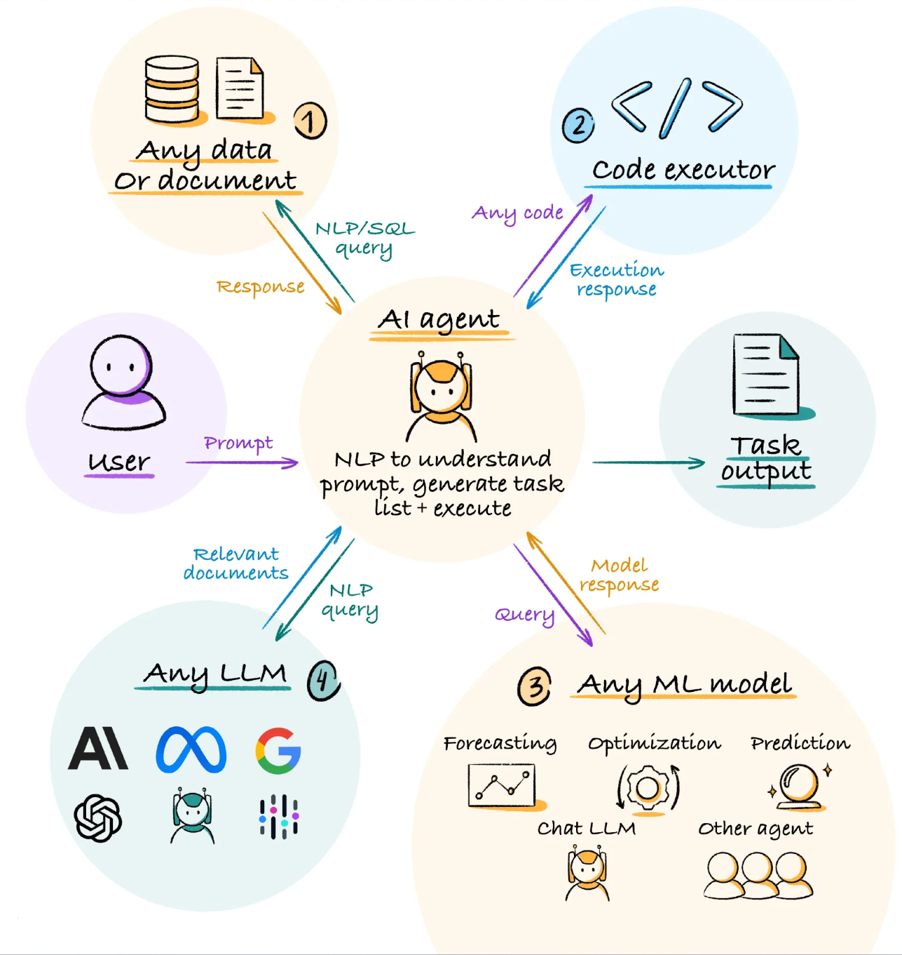
Recap
Project Topic
Personal Planning Assistant
Project Requirement
User Schedule Management
User Memo Management
Techinique Stack
Python (Langchain)
Implementation Direction
Chain, Agent, RAG

Slide 4
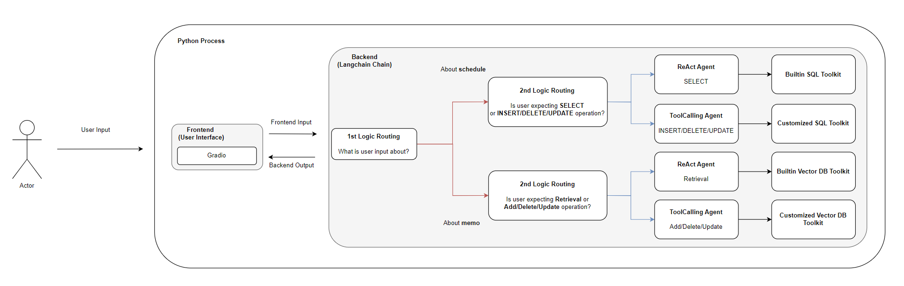
Project Architecture

Slide 5
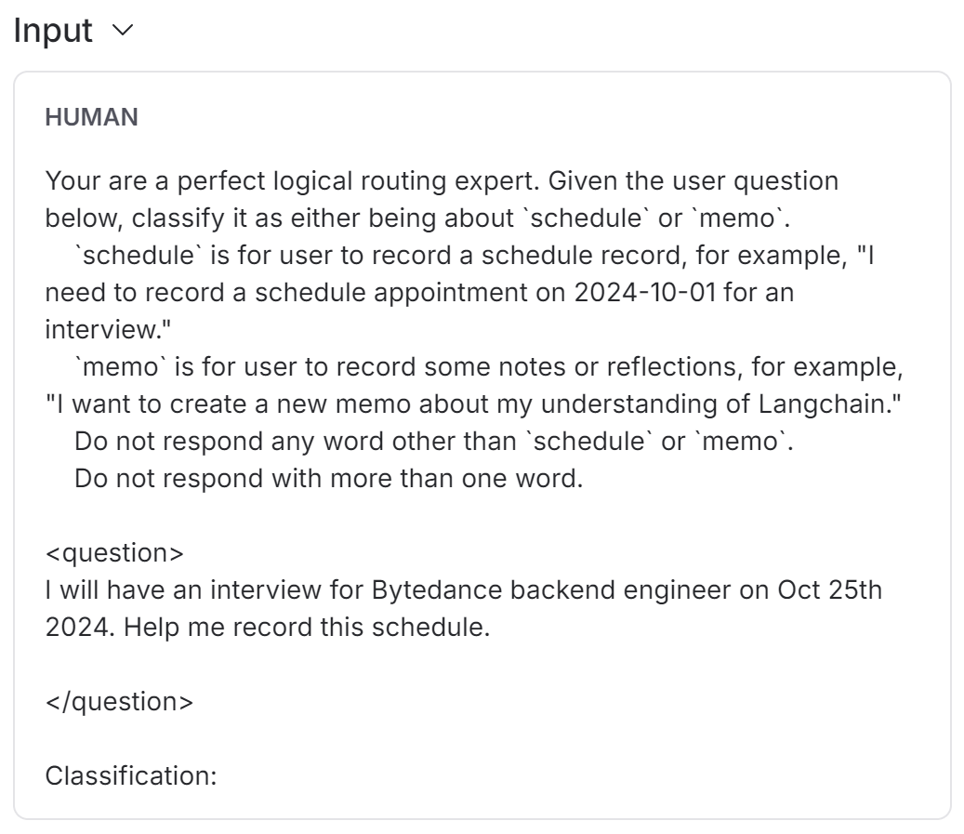
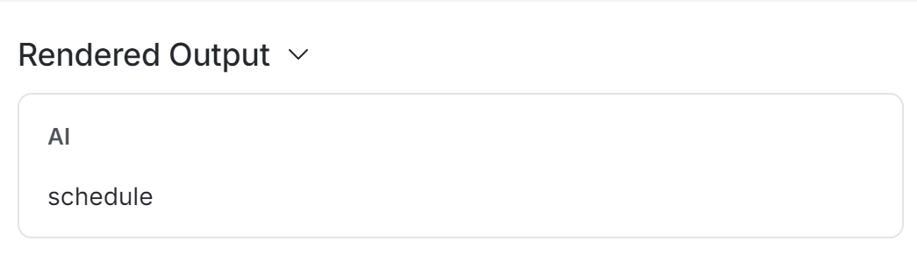
Logic Routing
Strictly structured LLM output
Rely on LLM capability of natural languange understanding

Slide 6
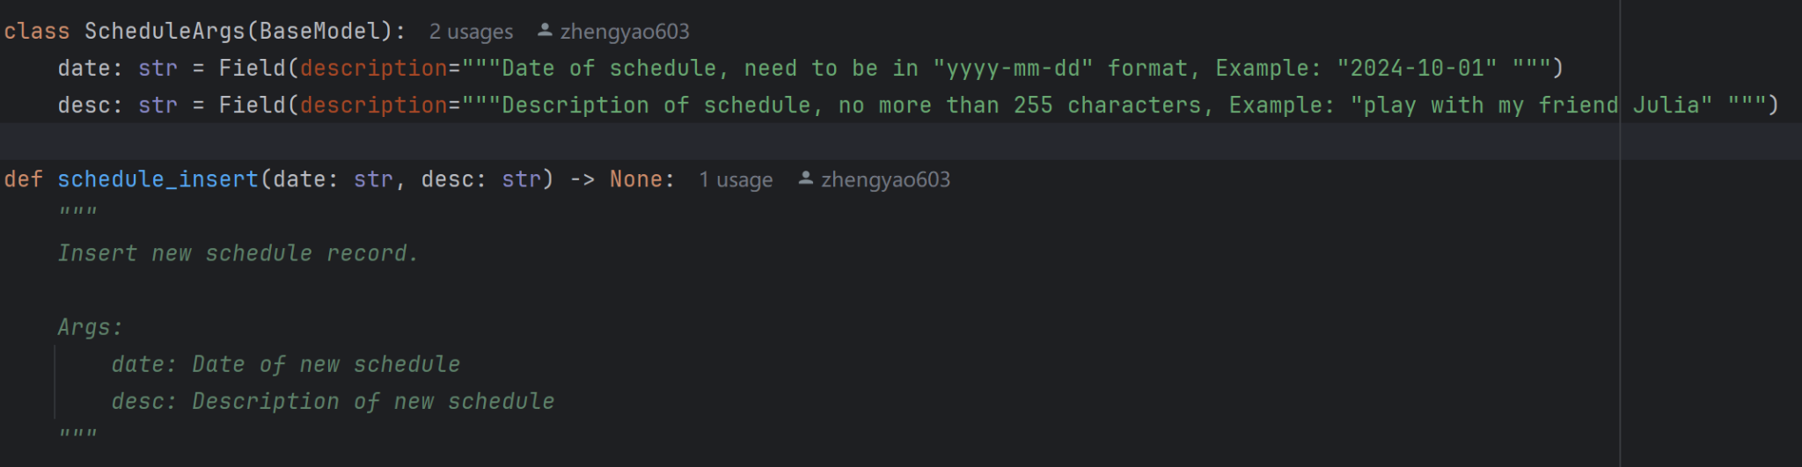
Tools
Set of structured functions that can be adopted by LLM
Can be business logic, DB commuication, RPC… Almost Everything！

Slide 7
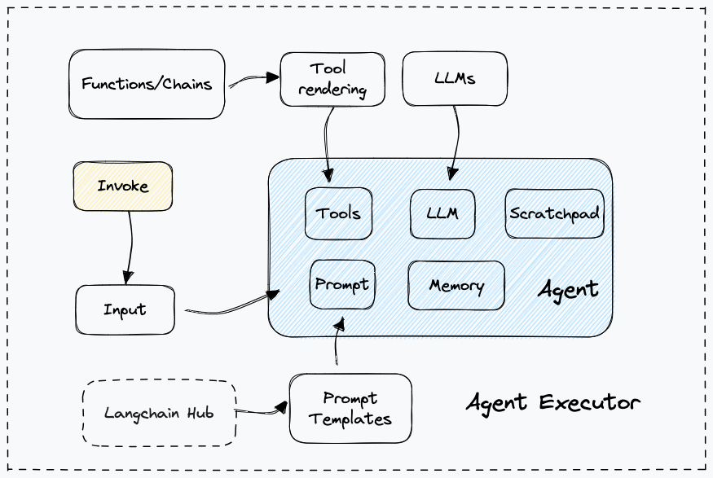
Agent
LLM with external functionalities
LLM (Brain) + Tool (Functions) + Memory + External Resources (e.g. Wikipedia)

Slide 8
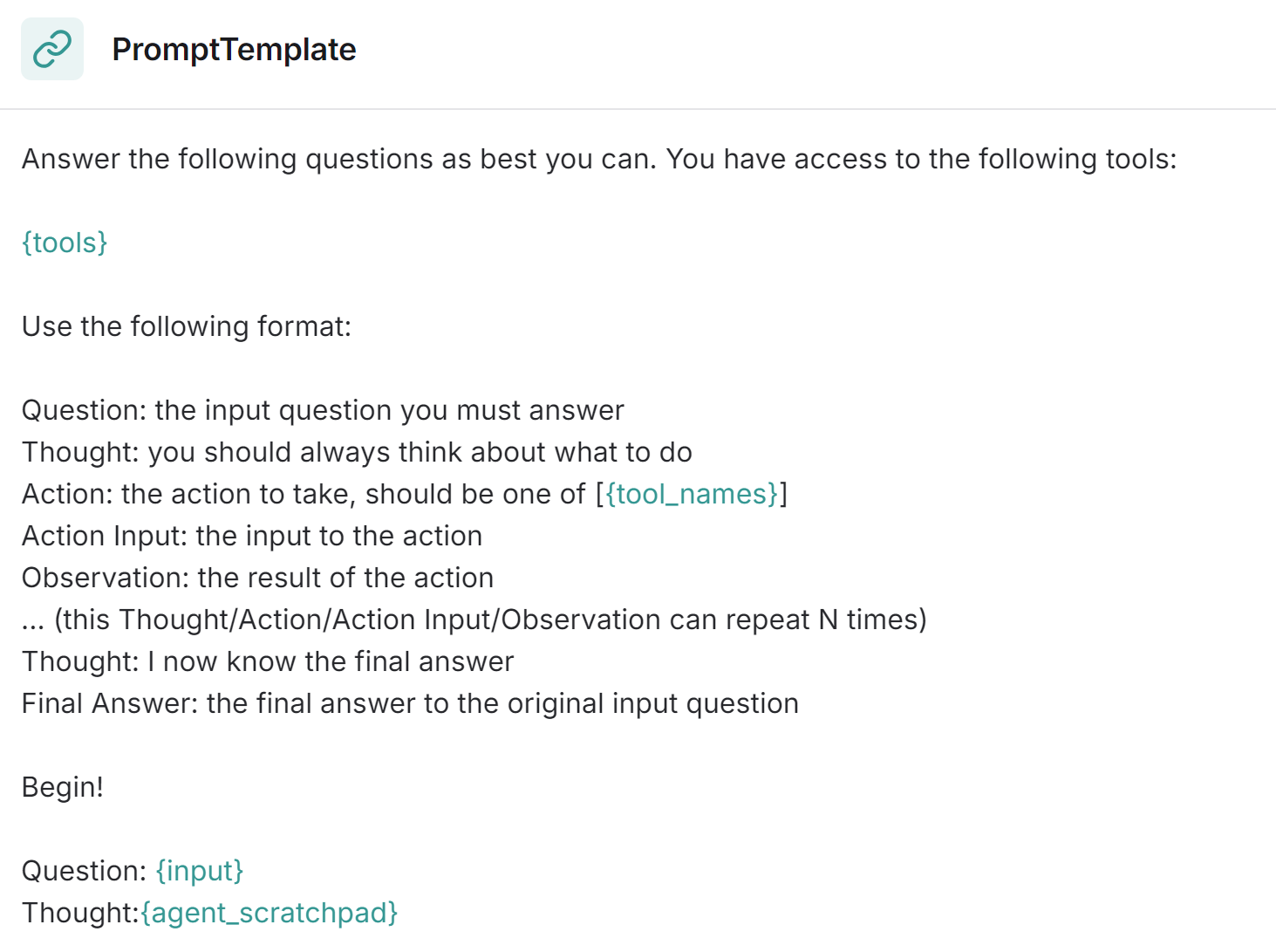
Agent - ReAct Agent
Idea comes from ReAct paper
Integrate LLM Reasoning and Acting
Chain Of Thought Prompting
Action Plan Generation
Thought -> Action -> Observation

Slide 9
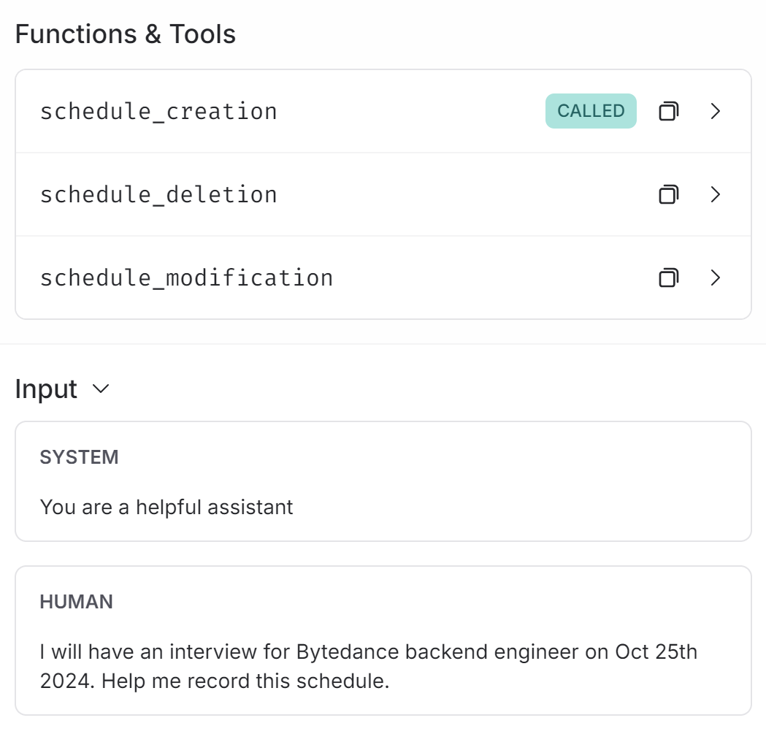
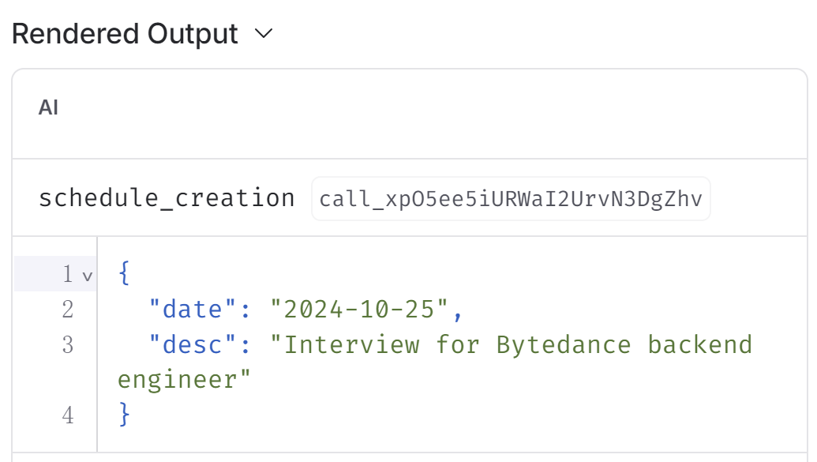
Agent - ToolCalling Agent
Focus more on function call decision making
Provide more structured and detailed function schema

Slide 10
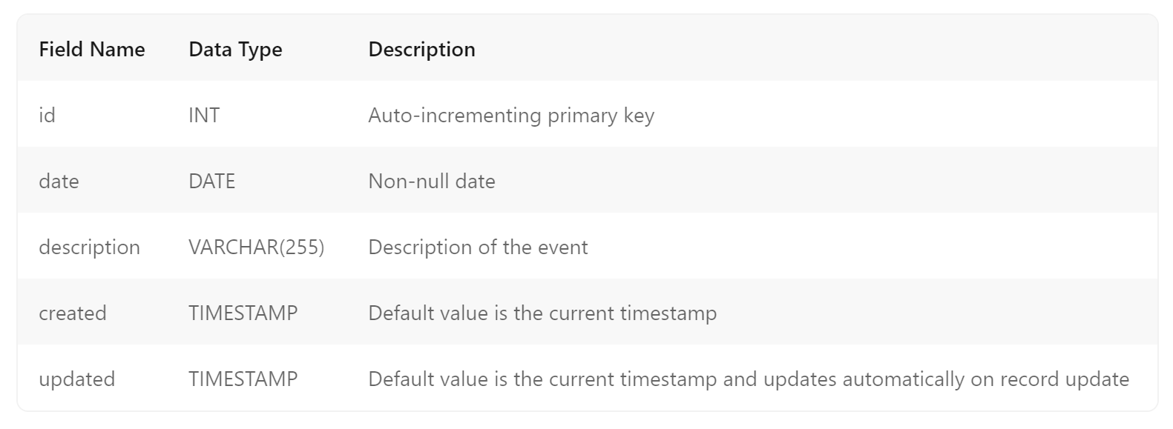
Schedule Management

Slide 11
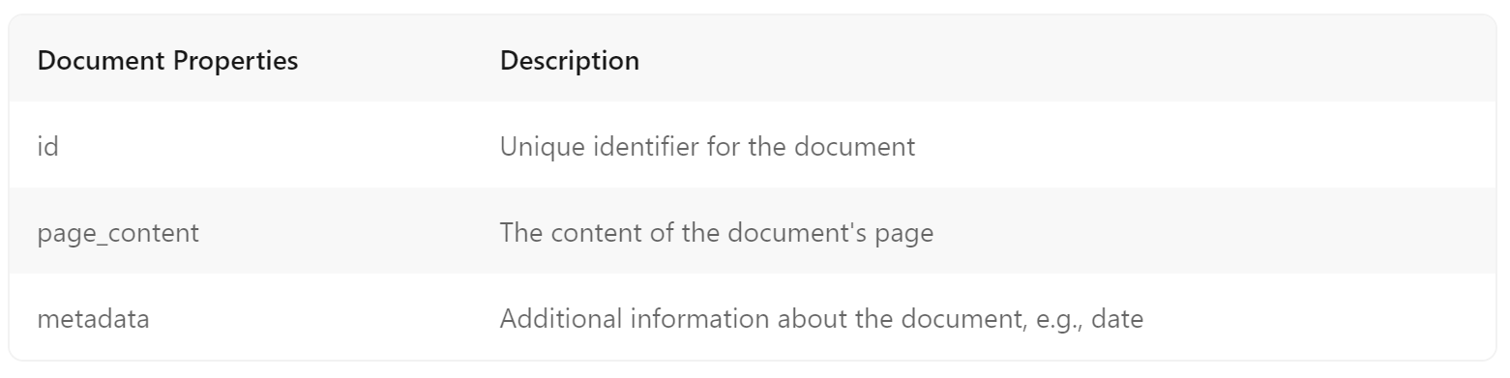
Memo Management

Slide 12
Future Directions
Time Tools
LLM understanding of relative time is not very well
e.g. tomorrow / next Friday ….
Other Performance Optimization …
e.g. promp improvement …
Propriate evaluation approach and result

Slide 13
References
Yao, S., Zhao, J., Yu, D., Du, N., Shafran, I., Narasimhan, K., & Cao, Y. (2022). ReAct: Synergizing Reasoning and Acting in Language Models. ArXiv, abs/2210.03629.
https://python.langchain.com/docs/introduction/
https://docs.smith.langchain.com/

Slide 14
Thank You

